Slide 1
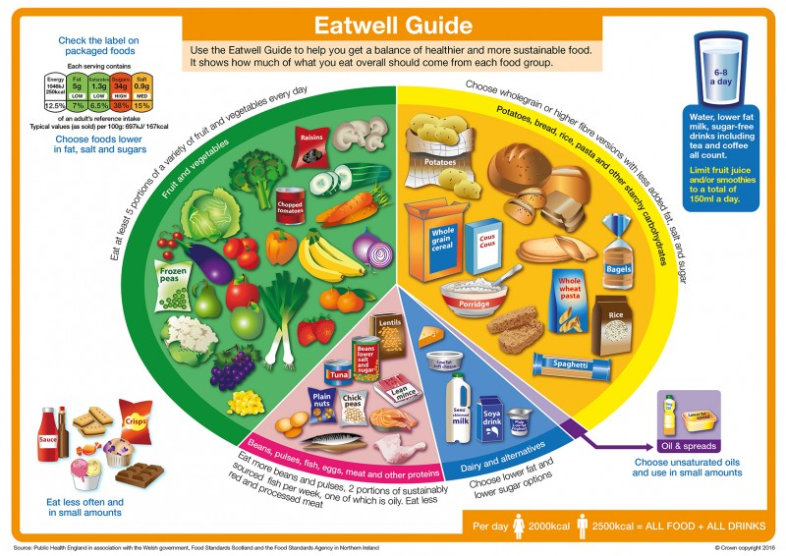
Eat well
The following activity is intended to summarise learning about a healthy, balanced diet within the context of the Eatwell Guide.

